Slide 1
Computers Principles 6Lecture/ Introduction of Computers
Civil Engineering Department College of Engineering / Diyala University/ 2015-2016.
Dr. Qasim Adnan Aljanabi

Slide 2
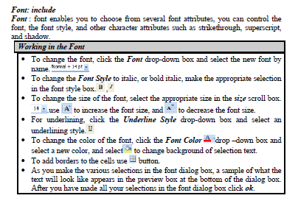

Slide 3
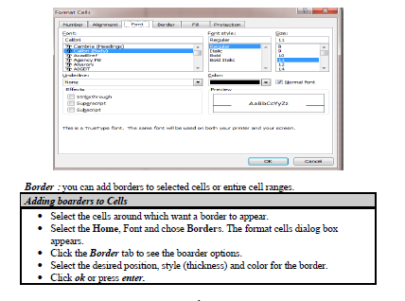

Slide 4
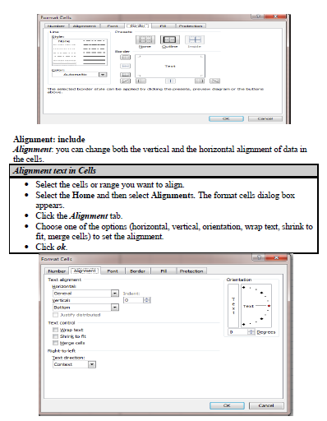

Slide 5
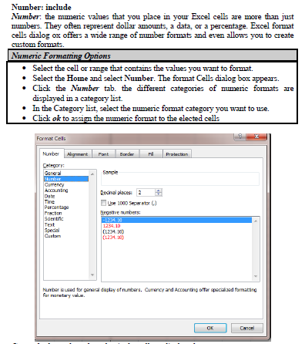

Slide 6
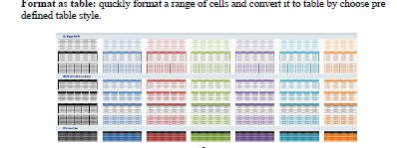
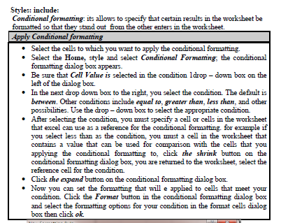

Slide 7
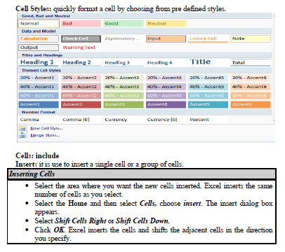

Slide 11
Questions - ?

